Slide 1
Assignment 13 Screenshots
Katie Hawthorne

Slide 2
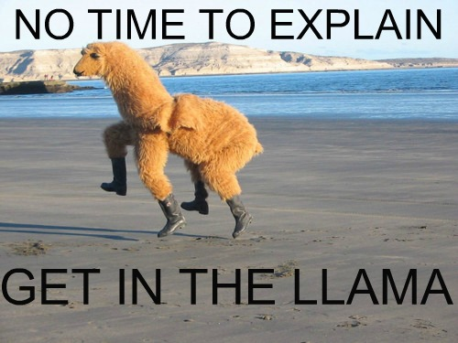

Slide 3
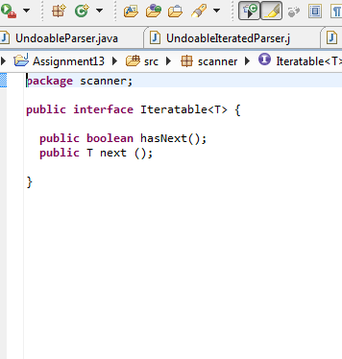
5 POINTS: Define your own iterator interface --Iteratable

Slide 4
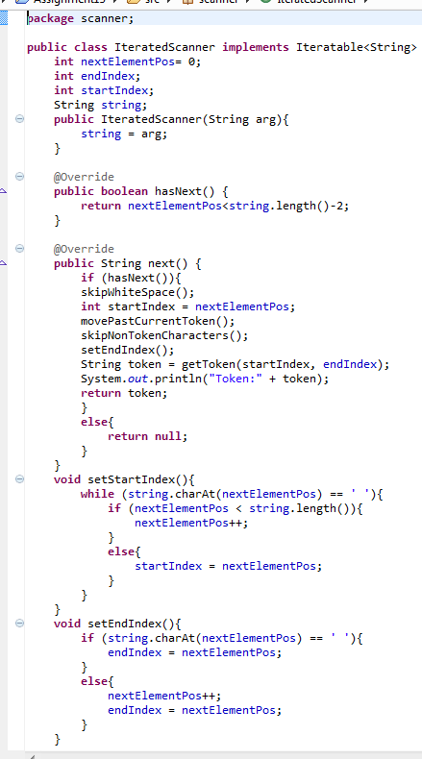
20 POINTS: Scanner correctly implements (only) the two iterator methods --IteratedScanner

Slide 5
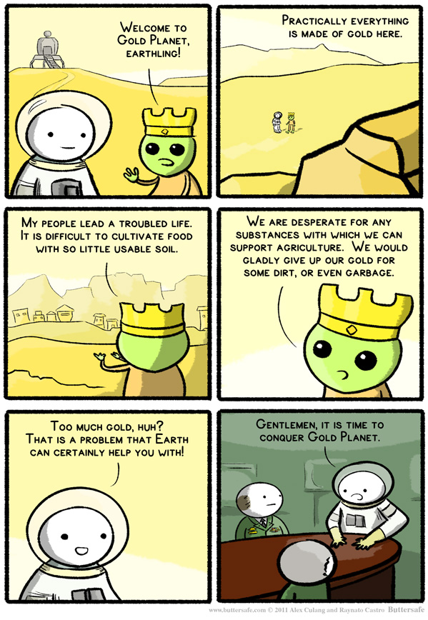

Slide 6
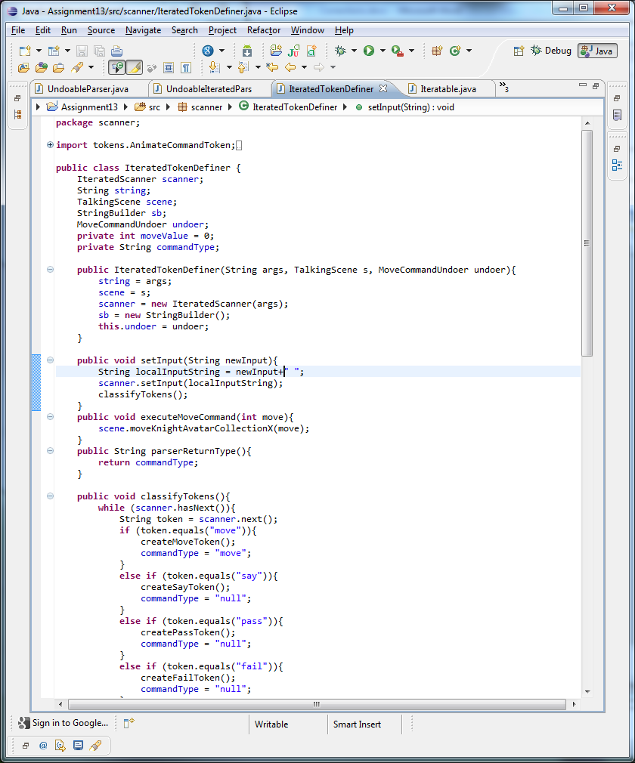
10 POINTS: Parser does not store the token collection and uses recursive descent parsing

Slide 7
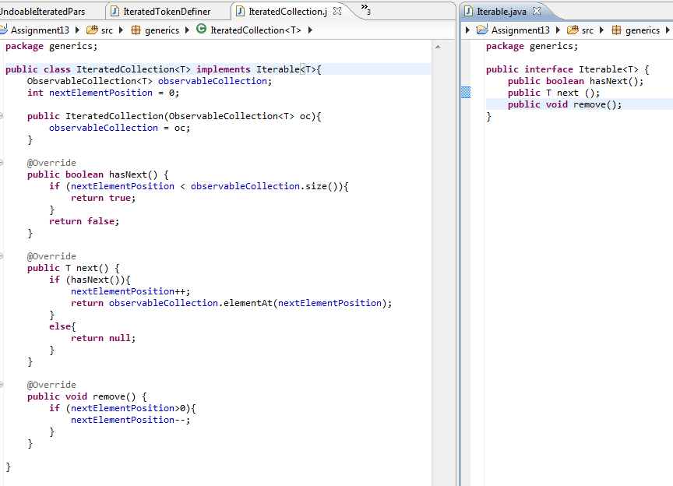
10 points: Define an iterator for the generic collection; generic collection implements Iterable

Slide 8

Correction: Screenshots.

Slide 9
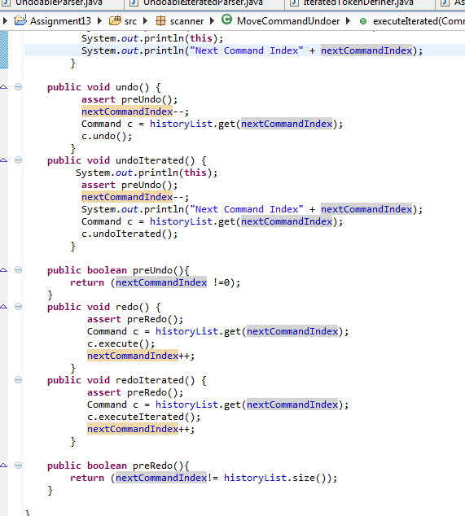
PRECONDITIONS 10 POINTS: Define and assert preconditions for undo in the history undoer MoveCommandUndoer.preUndo(); 10 POINTS: Define and assert preconditions for redo in the history undoer MoveCommandUndoer.preRedo();

Slide 10
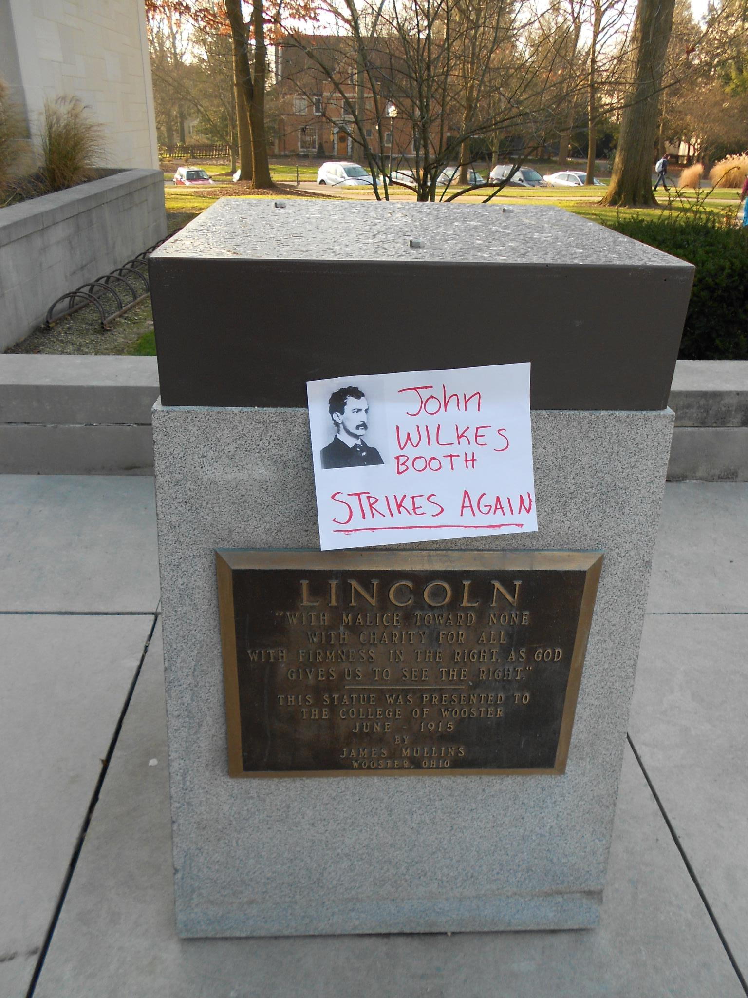

Slide 11
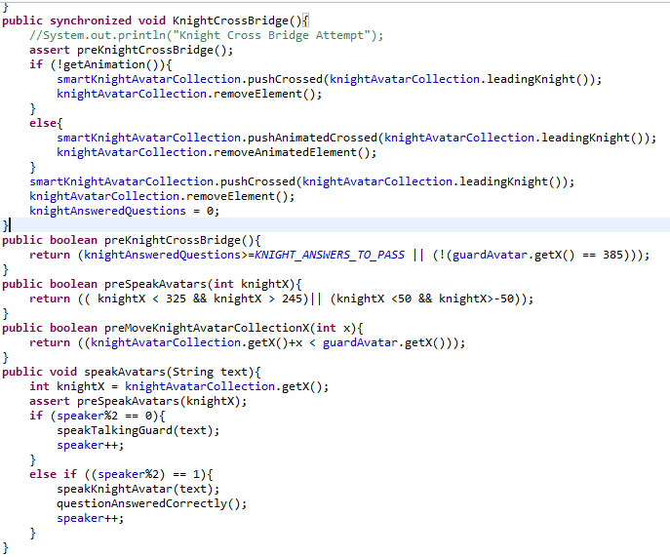
15 POINTS: Define and assert preconditions for the scene methods --TalkingScene.preSpeakAvatars(); --TalkingScene.preKnightCrossBridge(); --TalkingScene.preMoveKnightAvatarCollectionX(int x);

Slide 12
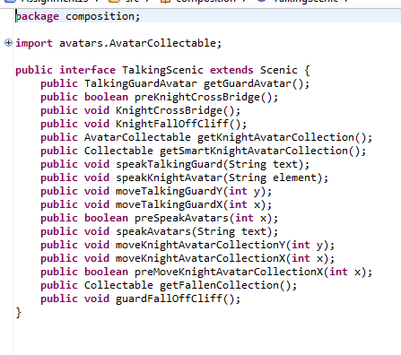
5 POINTS: All implemented precondition methods are added to appropriate interfaces --scanner.Undoer --composition.TalkingScenic

Slide 13
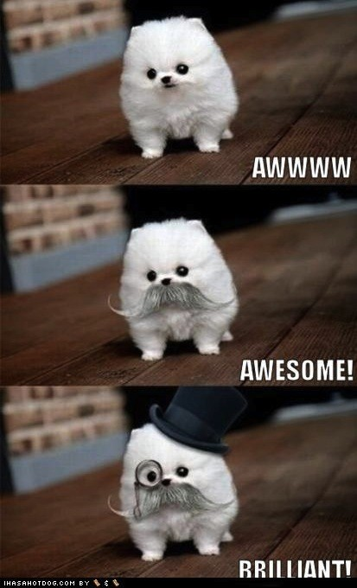
And thus concludes the last assignment. Implementation isn’t perfect and debugged, but it’s the most I could motivate myself to do.
Happy holidays!

